Slide 1
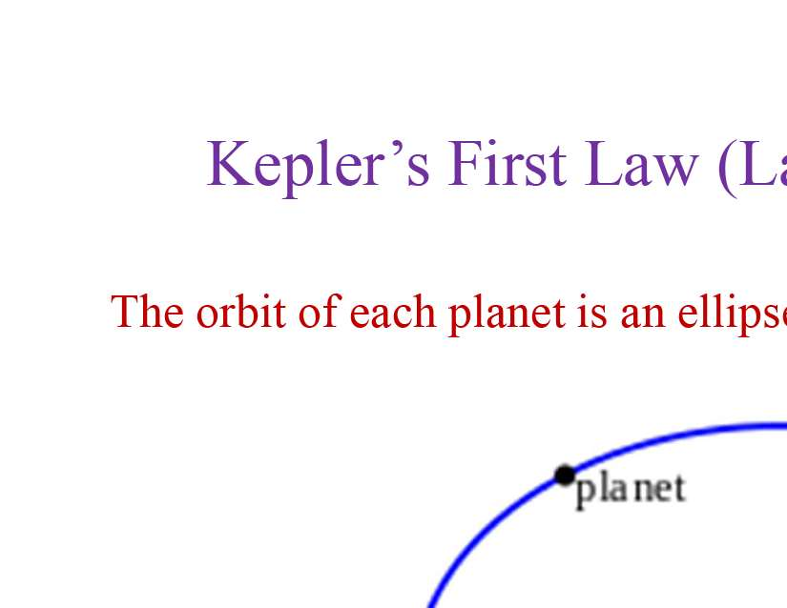
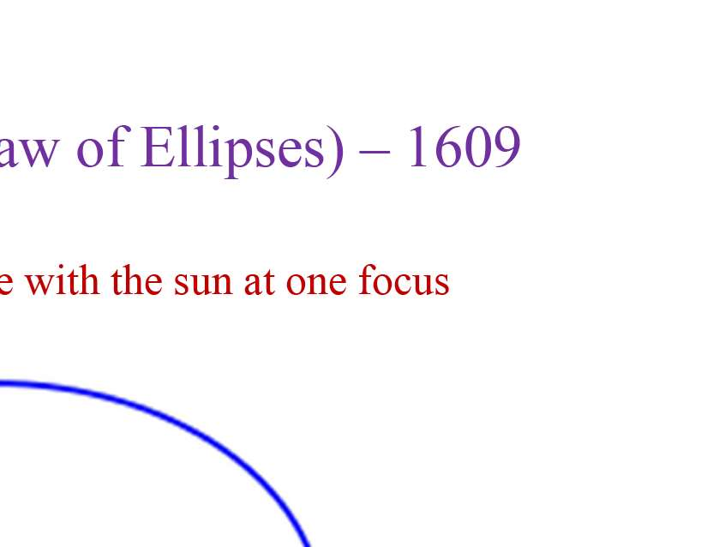
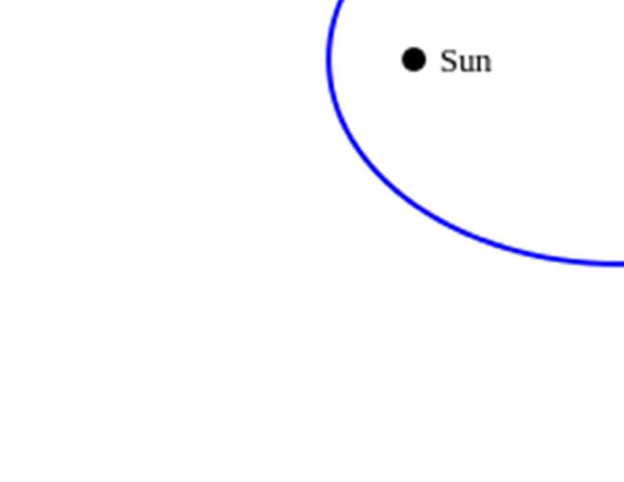
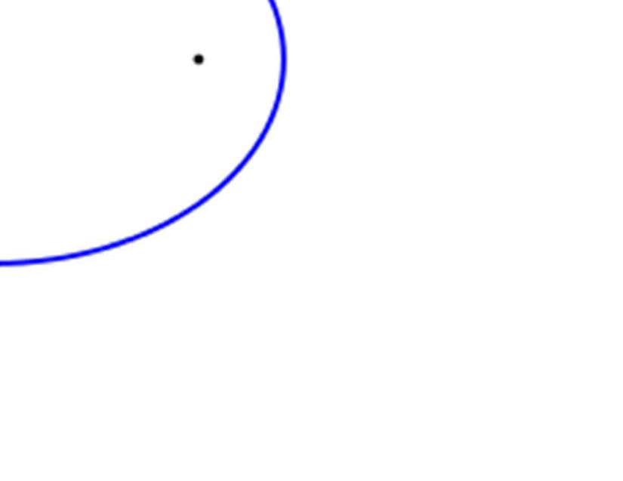

Slide 2
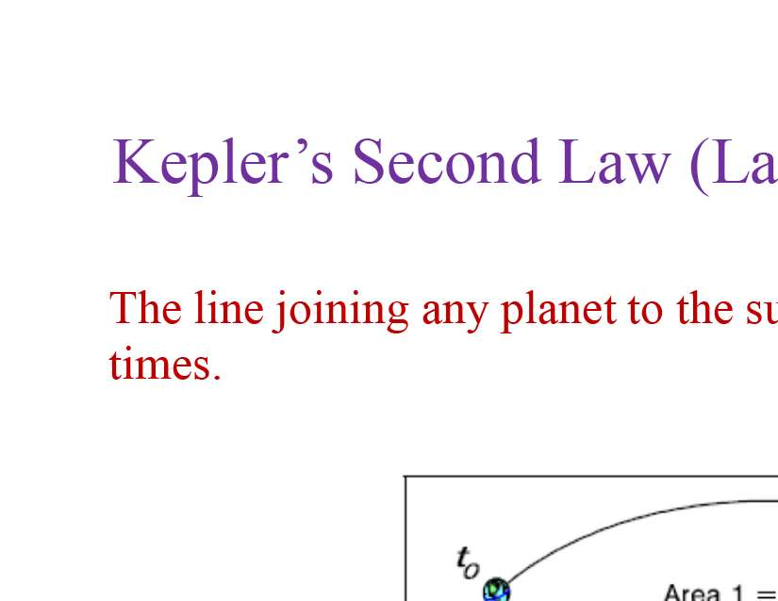
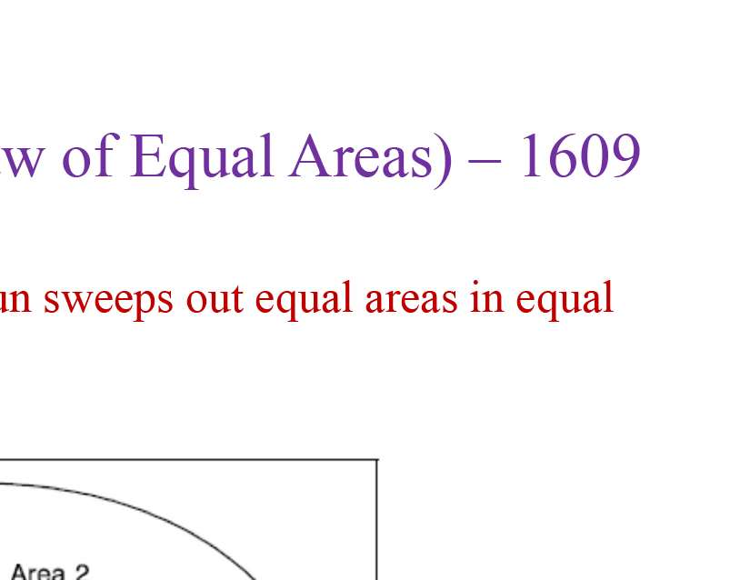
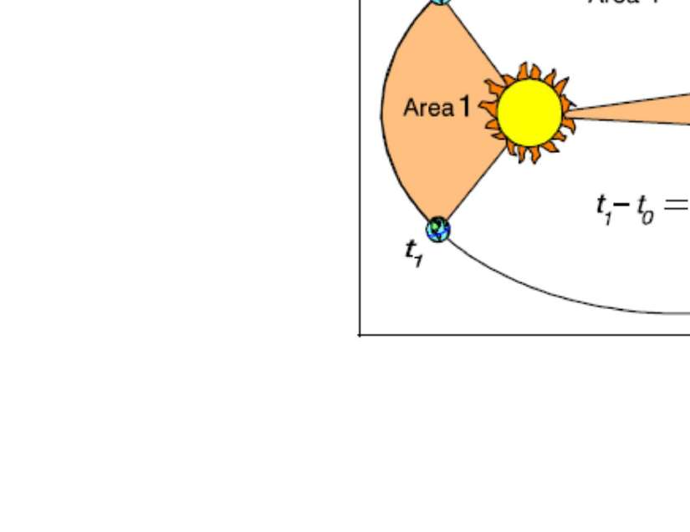
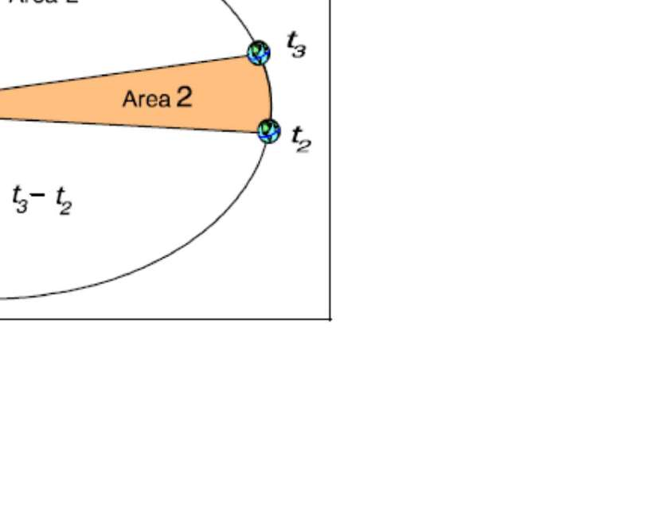

Slide 3
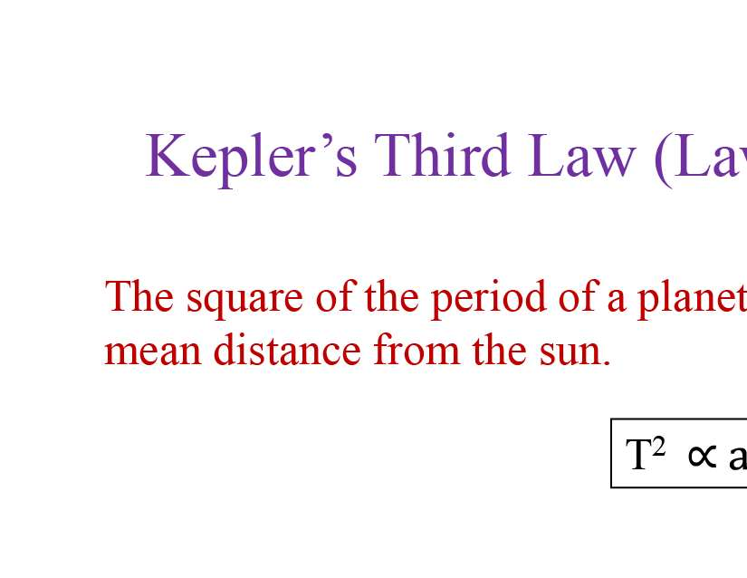
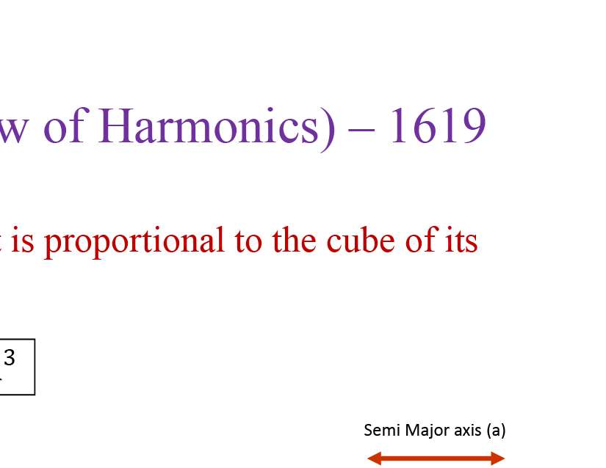
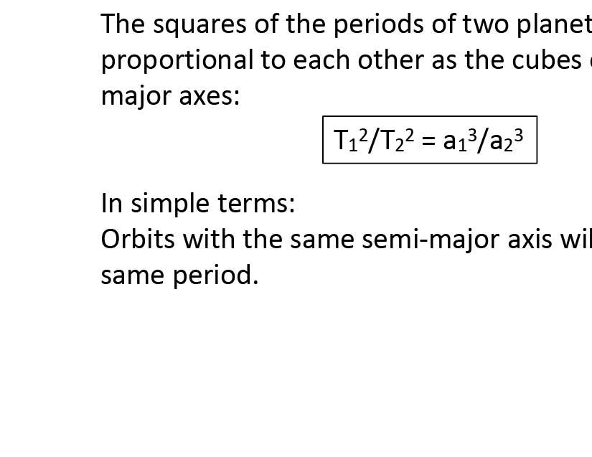
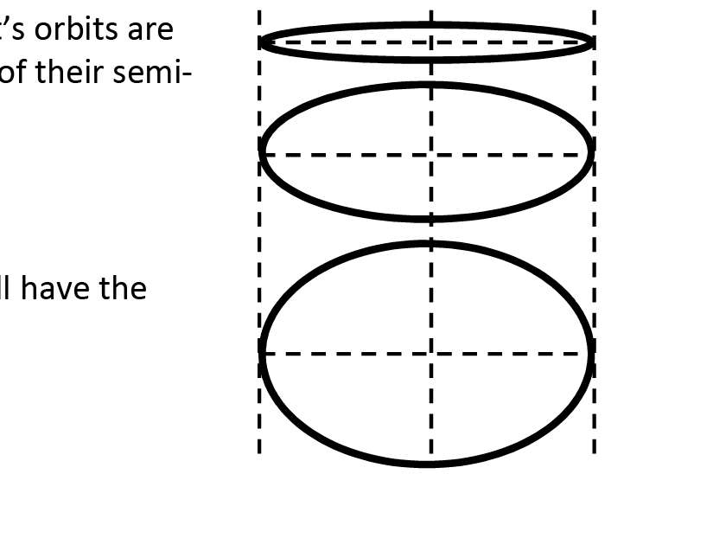

Slide 4
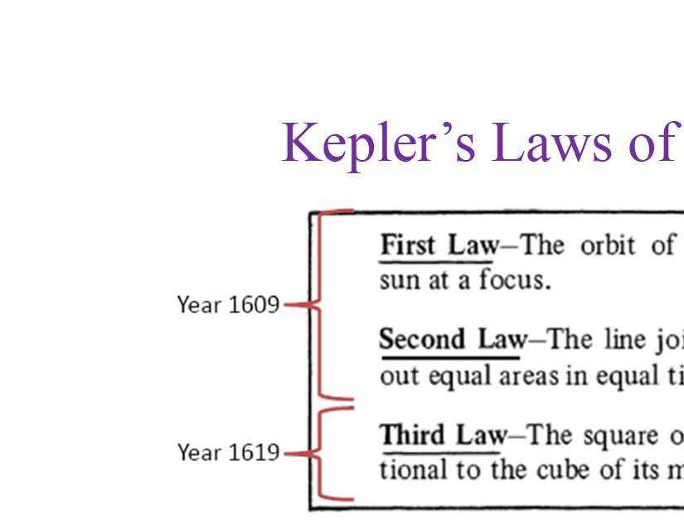
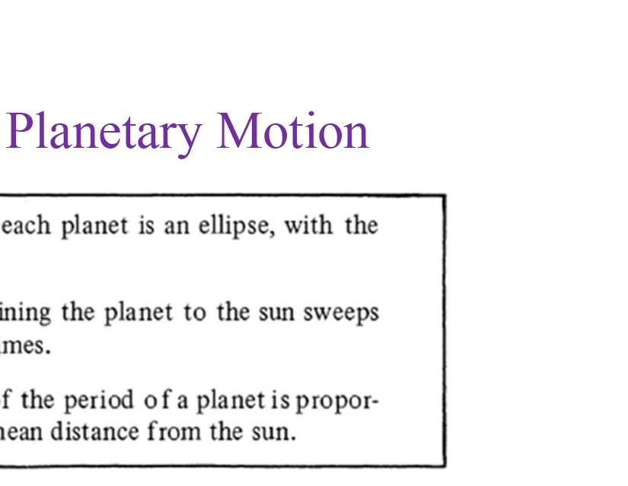
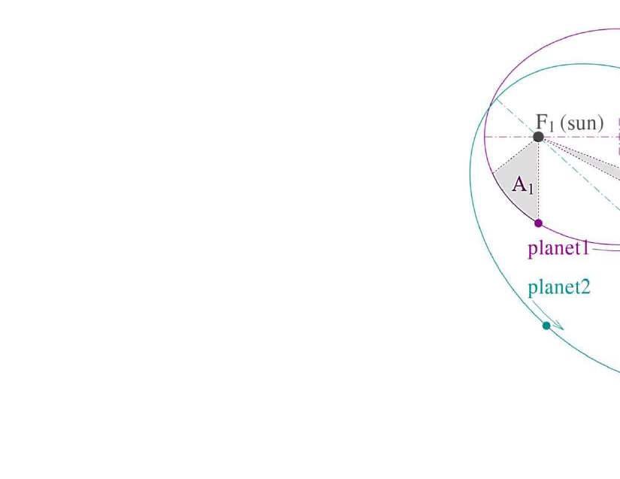
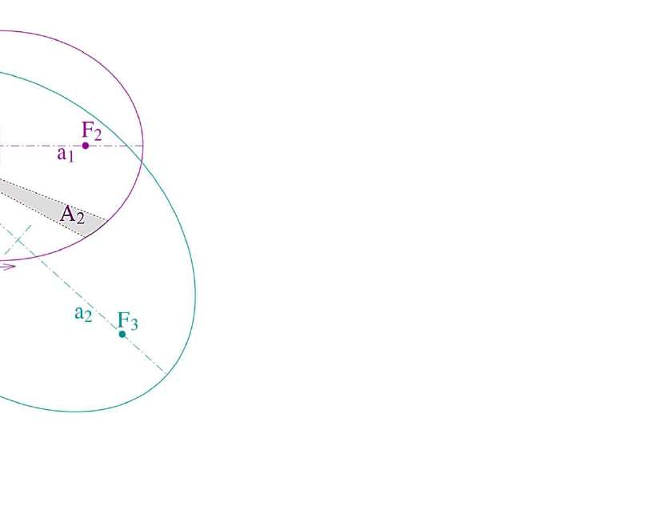

Slide 5
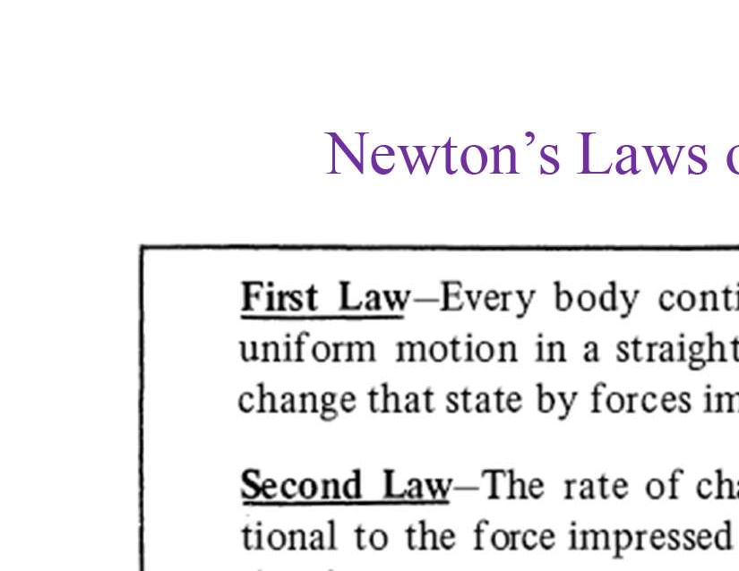
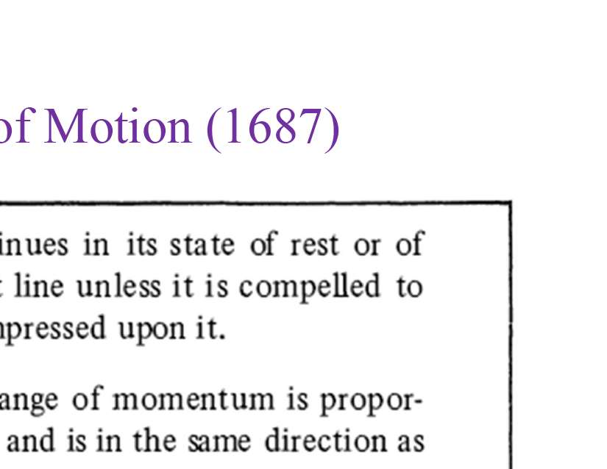
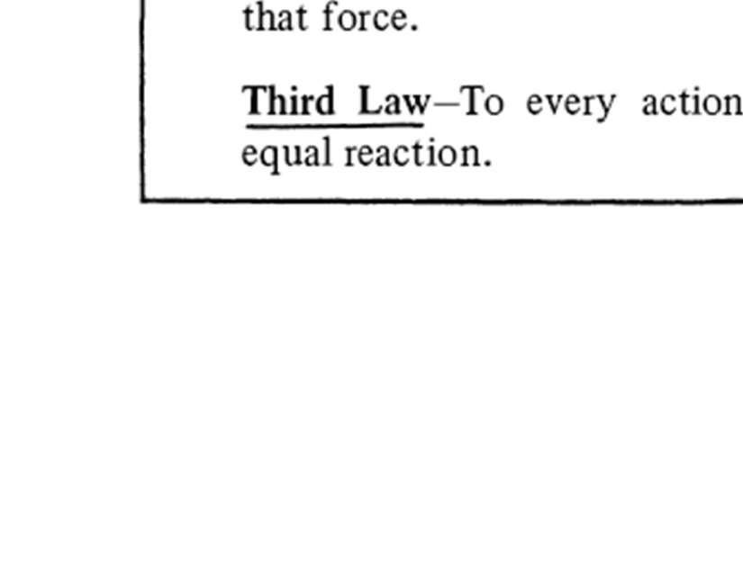
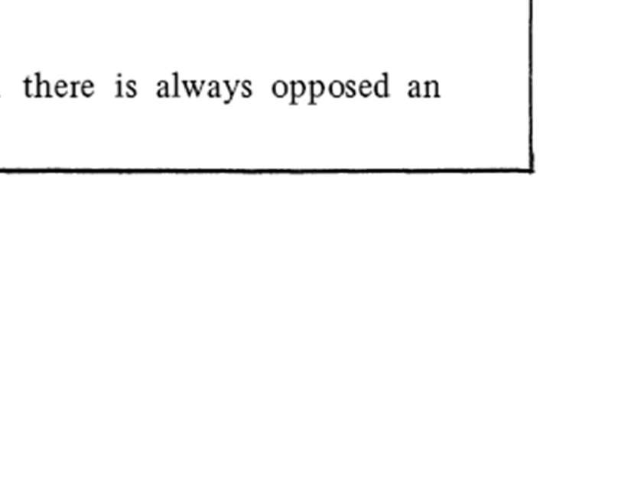

Slide 6
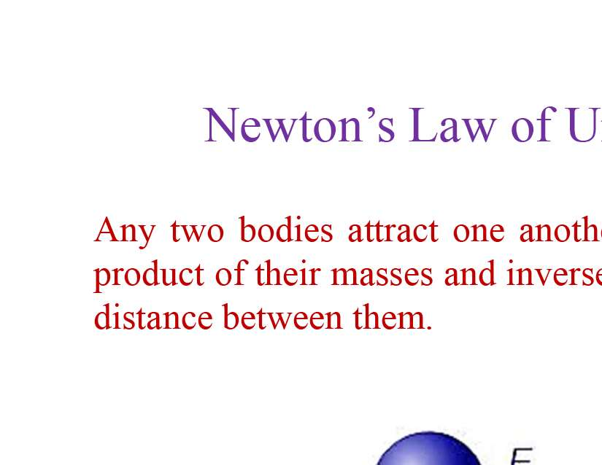
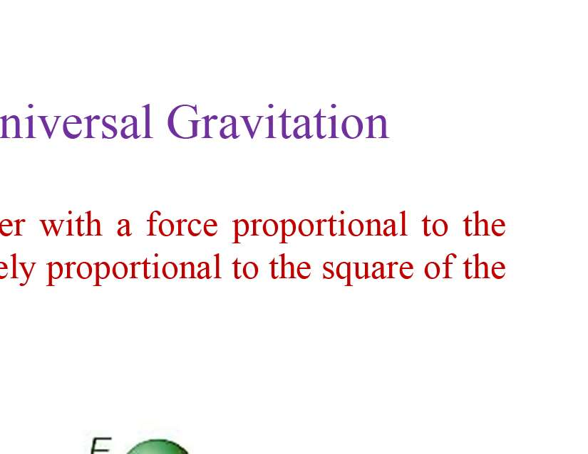
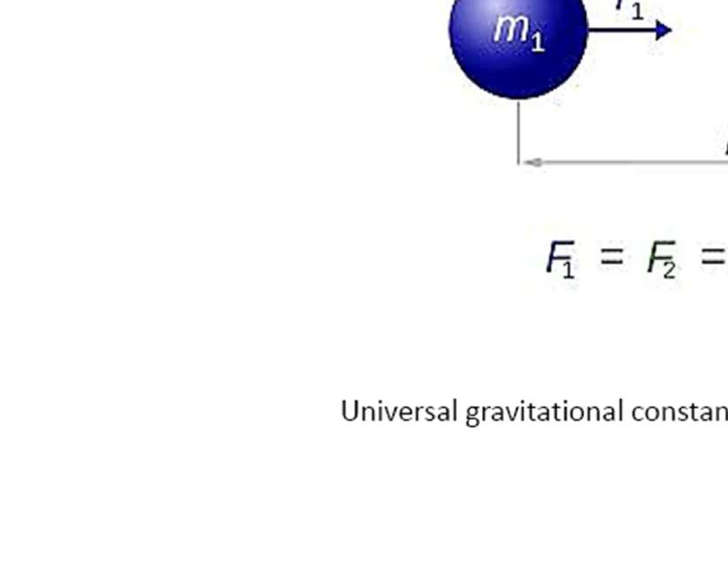
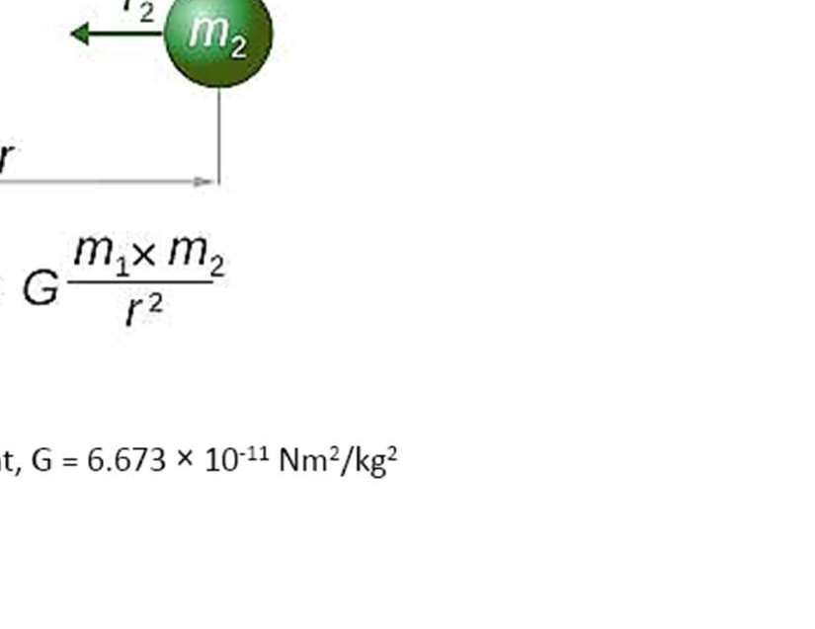

Slide 7
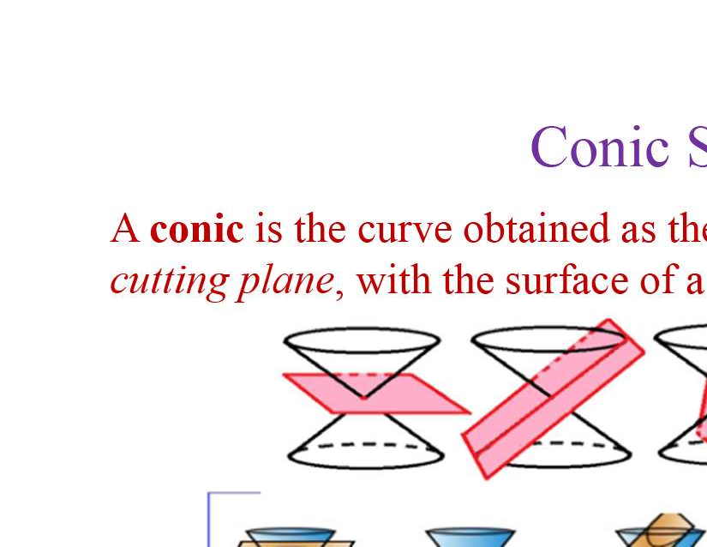
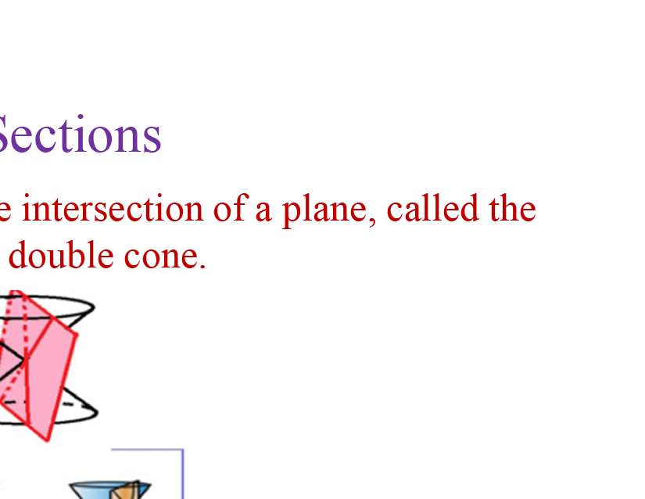
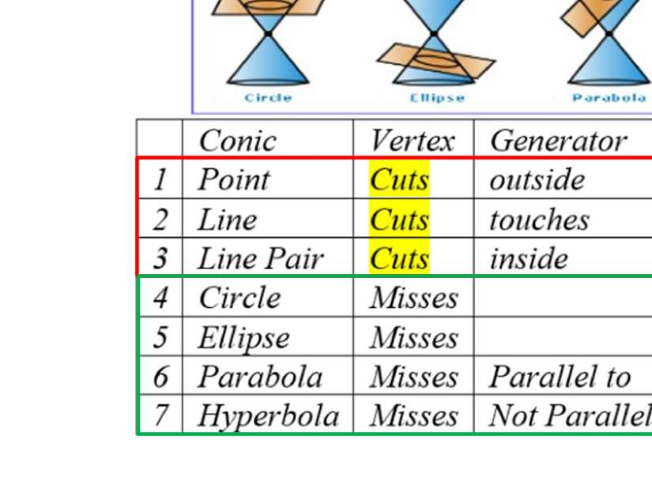
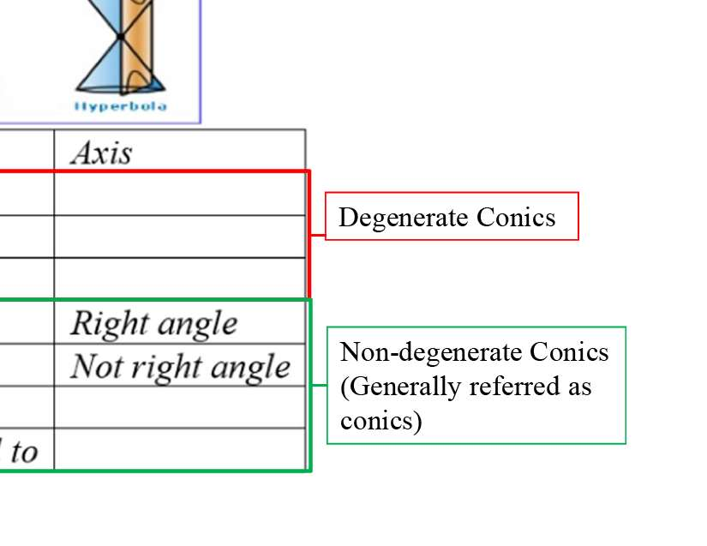

Slide 8
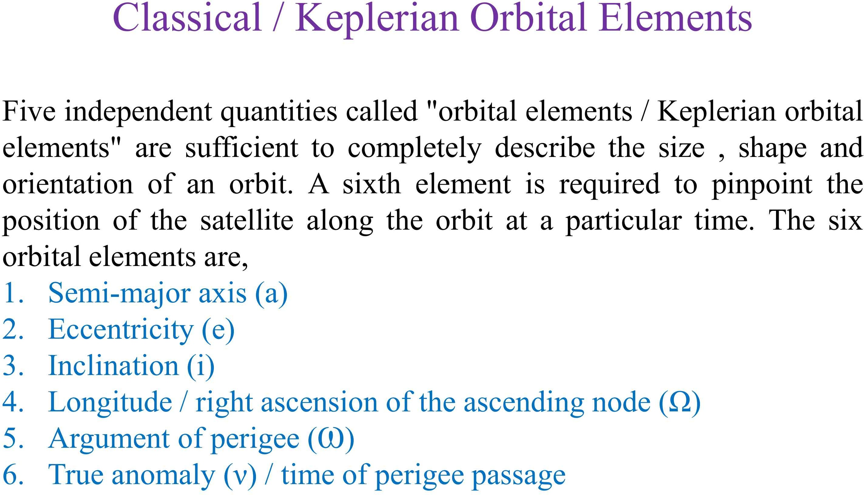

Slide 9
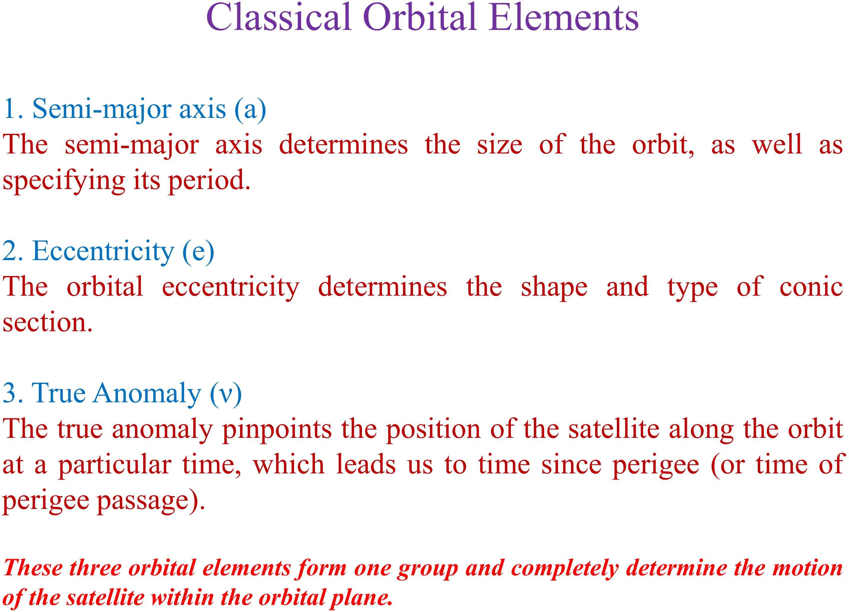

Slide 10
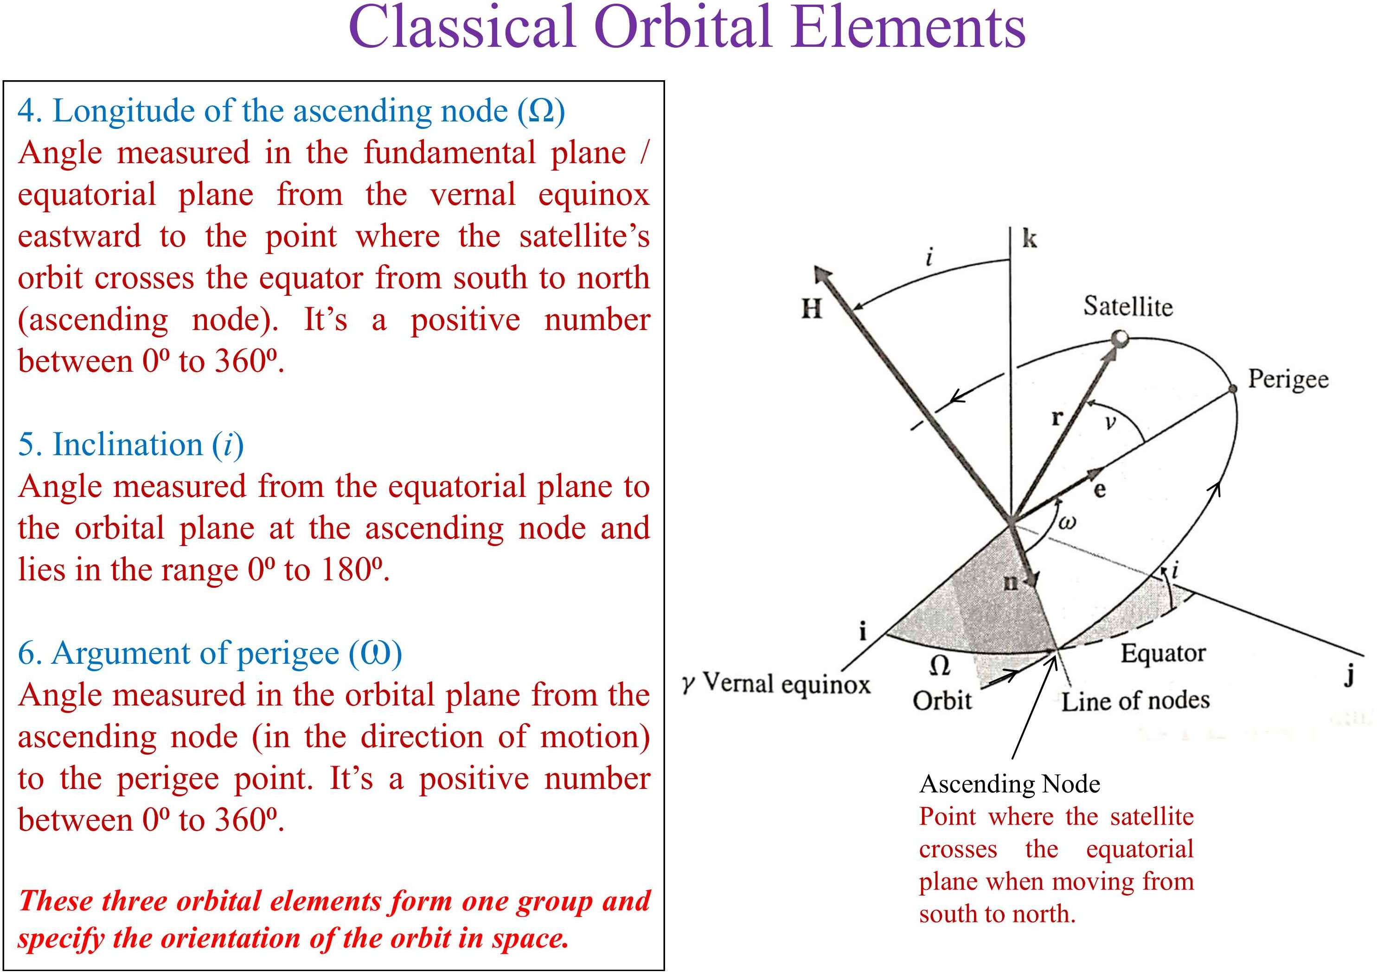

Slide 11
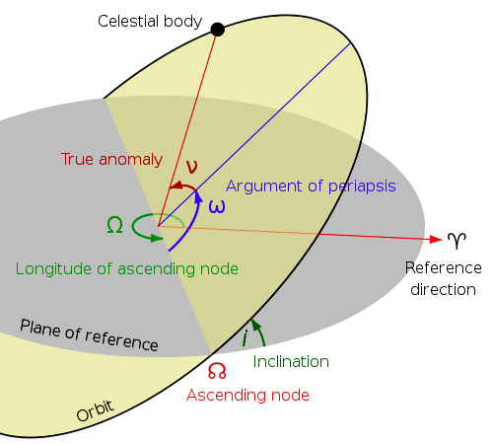
The Six Keplerian Elements
a = Semi-major axis (usually in kilometers or nautical miles)
e = Eccentricity (of the elliptical orbit)
v = True anomaly The angle between perigee and satellite in the orbital plane at a specific time
i = Inclination The angle between the orbital and equatorial planes
Ω = Right Ascension (longitude) of the ascending node The angle from the Vernal Equinox vector to the ascending node on the equatorial plane
ω = Argument of perigee The angle measured between the ascending node and perigee
Shape, Size, Orientation, and Satellite Location.

Slide 12
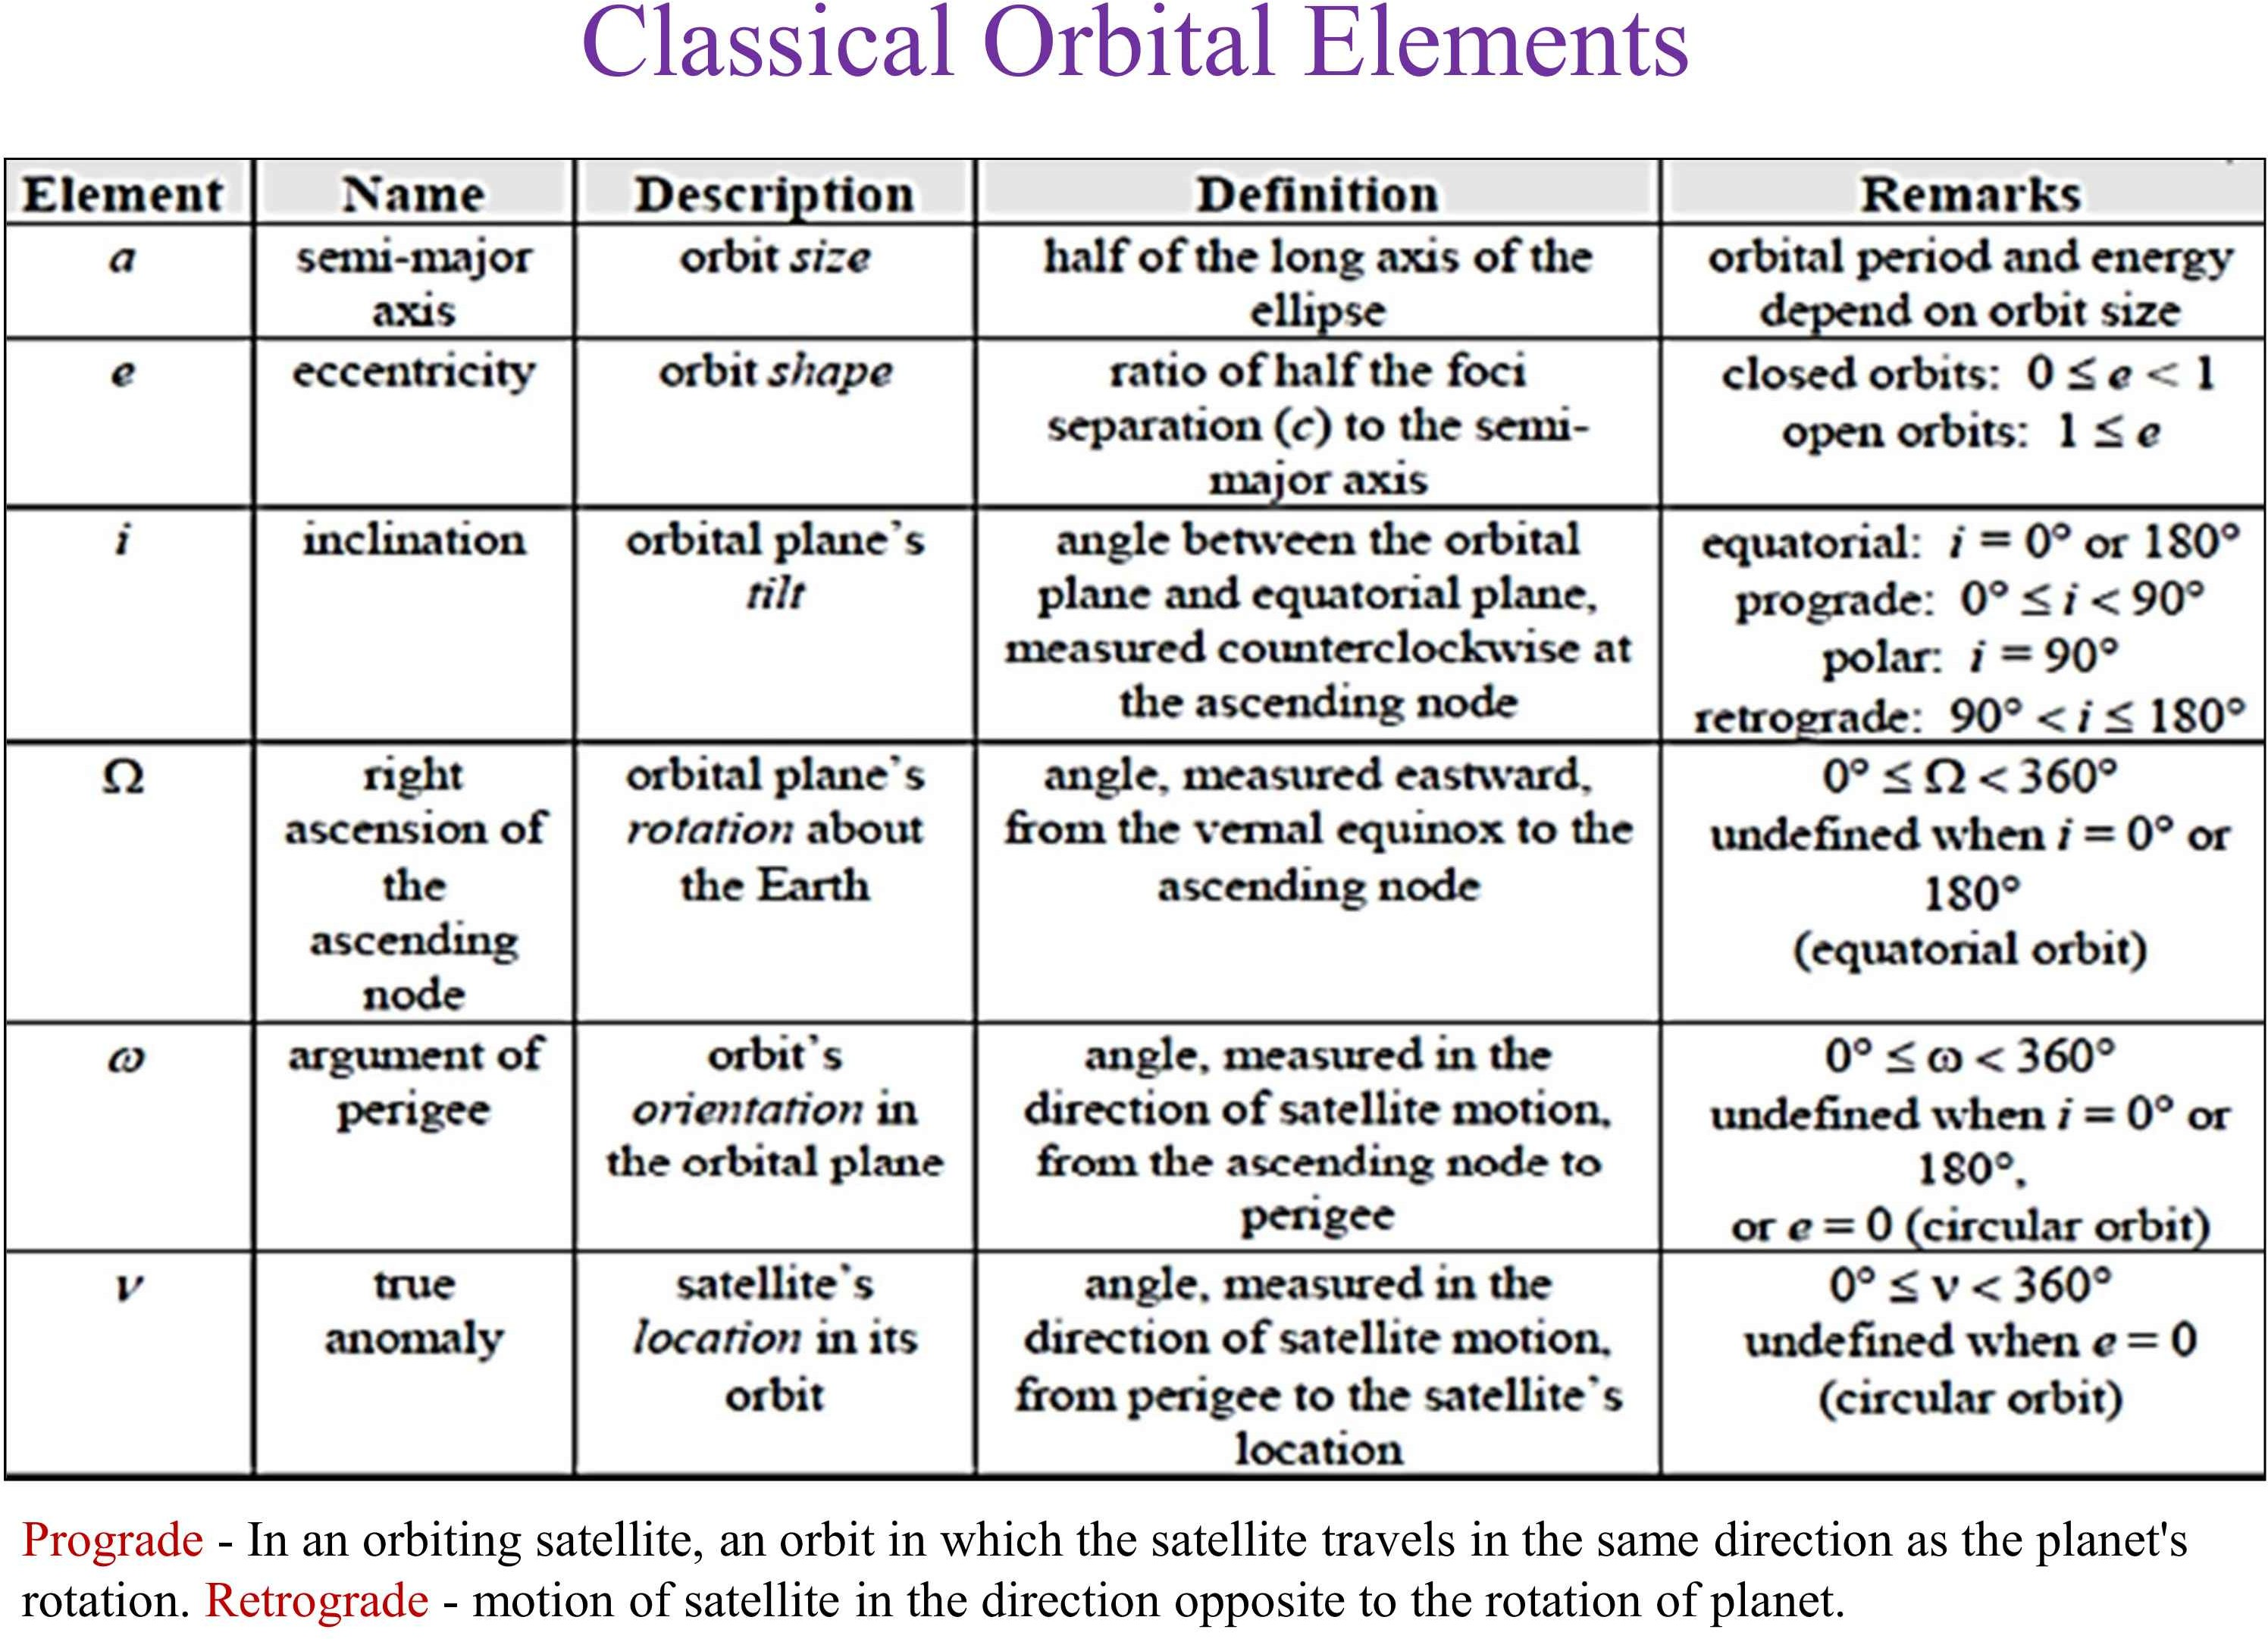

Slide 13
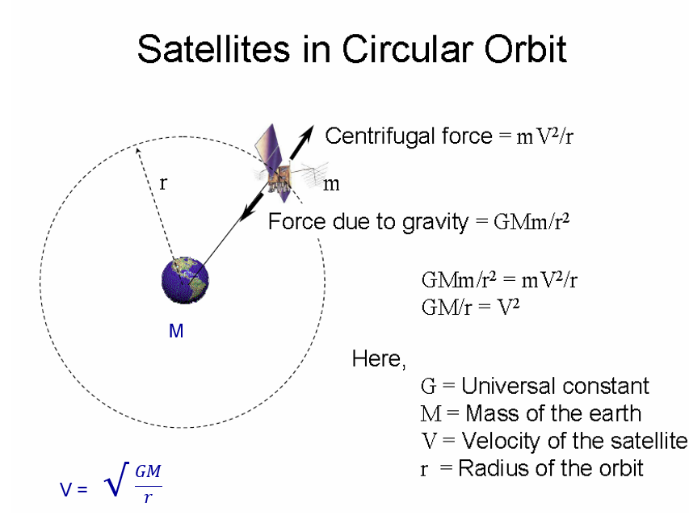

Slide 14
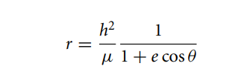
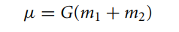
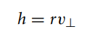
Orbit Equation :
This is the orbit equation, and it defines the path of the body m₂ around m₁, relative to m₁.
Remember that µ (Gravitational Parameter), h (Angular Momentum), and e (Eccentricity) are constants.
Since the orbit equation describes conic sections, including ellipses, it is a mathematical statement of Kepler’s first law, namely, that the planets follow elliptical paths around the sun. Two-body orbits are often referred to as Keplerian orbits.
The angular momentum (h) depends only on the azimuth component of the relative velocity
Eccentricity (e ) describes the amount by which an orbit deviates from a perfect circle. A value of 0 indicates a perfectly circular orbit, and between 0 and 1 indicate an elliptical orbit.

Slide 15
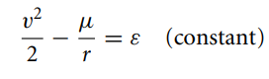
Energy Law:
This equation is a statement of conservation of energy, namely, that the specific mechanical energy is the same at all points of the trajectory
where ε is a constant. v²/2 is the relative kinetic energy per unit mass. (−µ/r) is the potential energy per unit mass of the body m₂ in the gravitational field of m₁. The total mechanical energy per unit mass ε is the sum of the kinetic and potential energies per unit mass

Slide 16
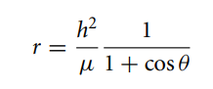
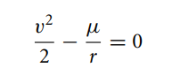
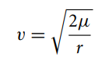
Parabolic Trajectories (e=1):
If the eccentricity equals 1, then the orbit equation becomes
As the true anomaly θ approaches 180◦, the denominator approaches zero, so that r tends towards infinity.
The energy of a trajectory for which e = 1 is zero so that for a parabolic trajectory the conservation of energy is :
In other words, the speed anywhere on a parabolic path is:

Slide 17
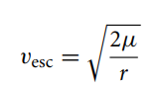
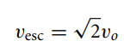
Parabolic Trajectories (e=1):
If the body m₂ is launched on a parabolic trajectory, it will coast to infinity, arriving there with zero velocity relative to m₁. It will not return.
Parabolic paths are therefore called escape trajectories.
At a given distance r from m₁, the escape velocity is given by
Let v_{o} be the speed of a satellite in a circular orbit of radius r. Then, we have
That is, to escape from a circular orbit requires a velocity boost of 41.4 percent.

Slide 18
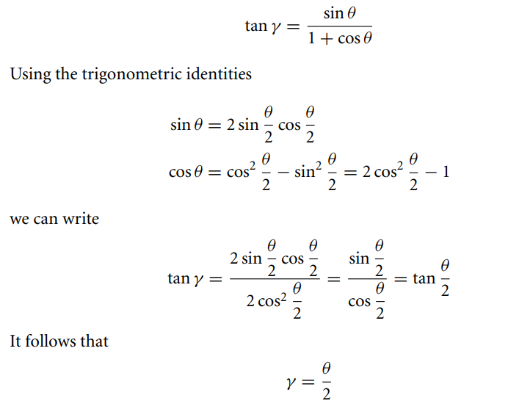
Parabolic Trajectories (e=1):
For the parabola, the flight path angle takes the form :
That is, on parabolic trajectories the flight path angle is one-half the true anomaly

Slide 19
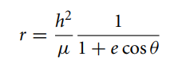
Hyperbolic Trajectories (e>1):
If e > 1, the orbit formula,
describes the geometry of the hyperbola shown in the Figure below.
The system consists of two symmetric curves. One of them is occupied by the orbiting body, the other one is its empty, mathematical image.
Clearly, the denominator of Equation goes to zero when
[[
cos θ = −1/e.
We denote this value of true anomaly
θ∞ = cos−1 (−1/e)

Slide 20
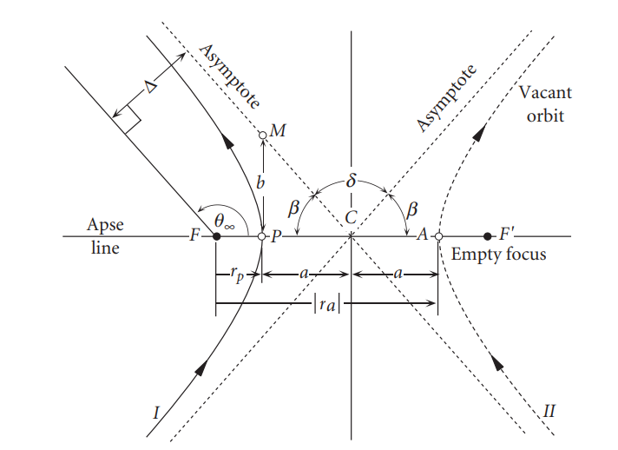
Hyperbolic Trajectories (e>1):

